Slide 1
本讲内容
k-NN分类

Slide 2
k-Nearest Neighbors
Definition: Given a query point p, and a distance function dist(), let q_{k} be a point in the database such that
  count( {q| dist(p,q) < =dist(p,q_{k}), q ∈D} ) = k-1
The k-nearest neighbors of p are all points q such that dist(p,q) <= dist(p,q_{k})
k=10
q_{k}
p

Slide 3
NN查找问题
给定空间中的一点q，从数据库中找出离q最近的点
例如：
  找出离某家剧院最近的饭店
  找出离空中某点最近的星球
  找出和某张照片最相似的照片

Slide 4
简单方法:
逐点比较
  min = ∞
  从集合中取任一点p，求p和q间的距离
  If，小于min, 则更新min
缺点：效率低

Slide 5
改进策略
对数据库中的数据建索引，如R-tree.
采用排除法，排除掉一些根本不可能成为NN的点。

Slide 6
R-Tree：一种多维空间索引技术
空间数据库
多媒体数据库
  图象、文本、视频等→特征向量 相似性查询
机器学习
  分类
  聚类
  异常检测等
  分子生物学等

Slide 7
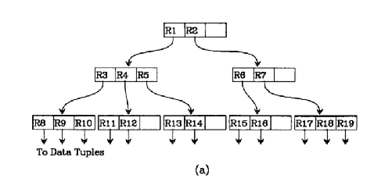
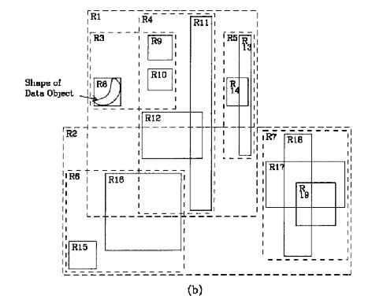
R-tree:Structure(I)
We will transverse through the R-Tree to give some idea of its structure

Slide 8
R-tree:Structure(II)
R1
We first move to the first layer of the R-tree which consist of the two nodes R1 and R2.
R2

Slide 9
R-tree:Structure(III)
R1
R4
R3
Then we move to the second layer under node R1 which consist of node R3, R4 and R5
R2
R5

Slide 10
R-tree:Structure(III)
R1
R4
R3
Then we move to the third layer under node R3 which consist of node R8, R9 and R10
R2
R5

Slide 11
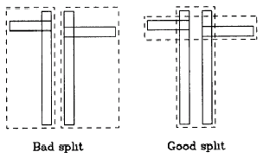
Maintenance of R-tree
Very much like the maintenance of B+ Tree. Take average O(log n) to search, insert and delete.
Concern when splitting nodes: Need to ensure that the bounding box have the smallest area

Slide 12
使用R-tree进行NN查找
Construct an index such as R-tree for the data
To prune off those MBRs(Minimum Bounding Rectangle) which can never contain a nearest neighbor.

Slide 13
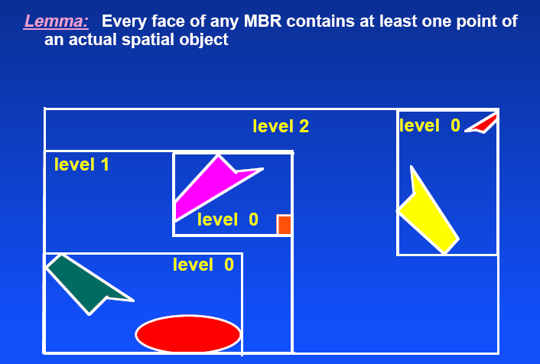
将R-tree用于NN查找

Slide 14
assuming this is the leftmost point
MBR(R)
then left border can be shifted here

Slide 15
assuming this is the leftmost point
MBR(R)

Slide 16
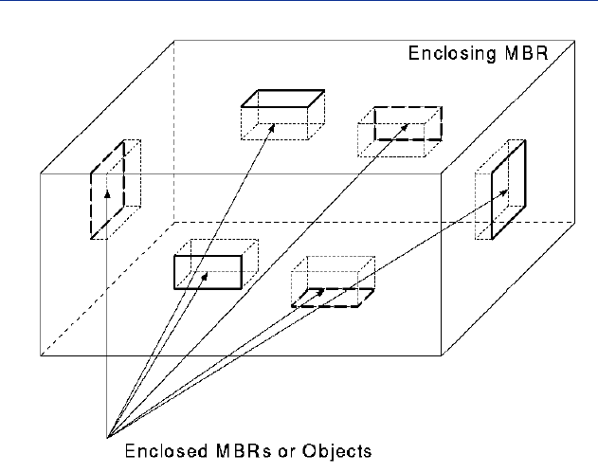
The MBR Face Property in 3-d

Slide 17
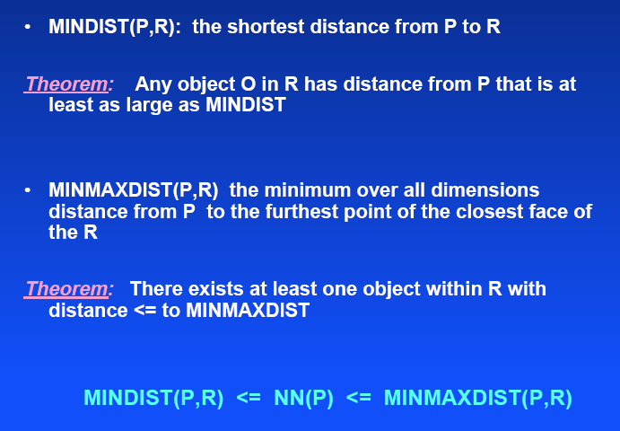
NN Metrics

Slide 18
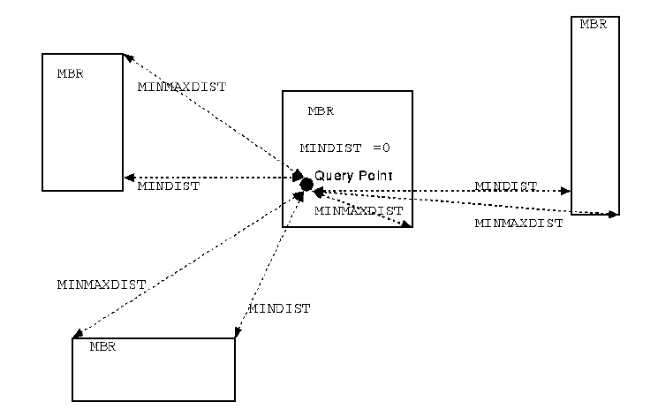

Slide 19
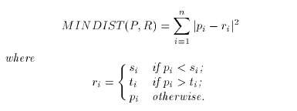
其中：s为左下角，t为右上角

Slide 20
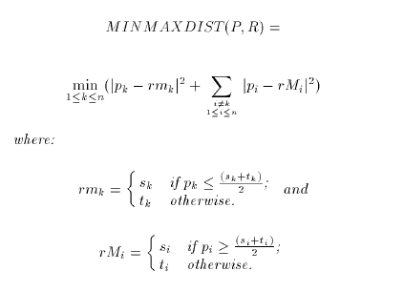

Slide 21
Pruning策略
an MBR R is discarded if there exists an R’ s.t.
  MINDIST(P,R) > MINMAXDIST(P,R’)

Slide 22
实际上，MinDist是下届，MaxMinDist是上届。
查找的过程是拿别人的下届和当前的最小上届进行比较，如果下届大于上届，则删除，否则，继续比较
尽早减小上届。提高算法性能。

Slide 23
R-tree: Finding Nearest Neighbor
First problem to be solve:
  Given a query point p and a minimum bounding rectangle (MBR), find an upper bound and lower bound for the distance r such that there exists at least one point in the MBR that is within a distance of r from p.
Why ?
  To facilitate some form of ranking to prune off uninteresting MBRs
  Eg. we can prune off MBR3 and MBR4.
p
MBR
r
distance
MBR1
MBR2
MBR3
MBR4

Slide 24
1-NN Algorithm for R-tree(II)
best first traversal of the nodes in the R-tree.
A heap is maintained for storing every MBR

Slide 25
1-NN Algorithm for R-tree(III)
The algorithm first starts from the root MBR of the R-tree and places its children MBRs into the heap
Within the heap, the MBRs are ordered based on ascending MinDist

Slide 26
1-NN Algorithm for R-tree(IV)
then repeated recursively beginning from the MBR at the top of the heap again by taking its children MBRs and inserting them into the heap.
The algorithm maintains a variable Best which is initially set to ∞and are updated later

Slide 27
k-NN Algorithm
Keep a sorted buffer of at most k current nearest neighbors
Pruning is done according to the distance of the furthest nearest neighbor in this buffer

Slide 28
k-NN分类
每个训练样本都看作n维空间中的一个点。
给定一个未知样本（类似于查询点q）， 首先找到该样本的k个近邻，将这k个近邻按照类标号进行分组，未知样本最终被分到组员最多的那个组。

Slide 29

Exercise
x
x
x
x
x
x
x
o
o
o
o
x
x
o
x
How is star classiﬁed by:
(i) 1-NN (ii) 3-NN (iii) 9-NN (iv) 15-NN (v) Rocchio?

